Slide 1
HR ANALYTICS
For employee retention and job satisfaction

Slide 2
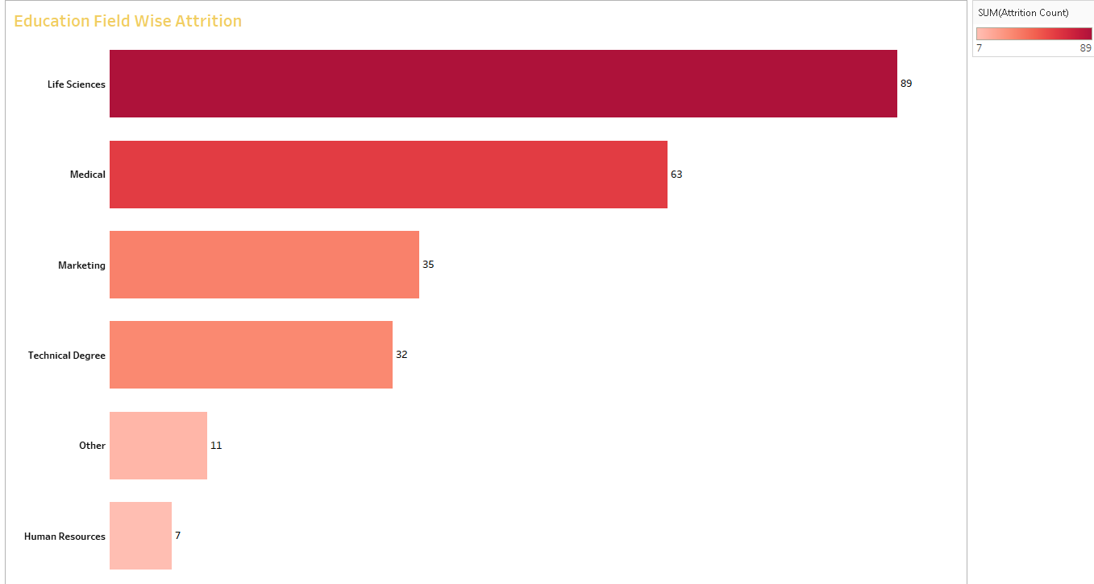
EDUCATION WISE ATTRITION

Slide 3
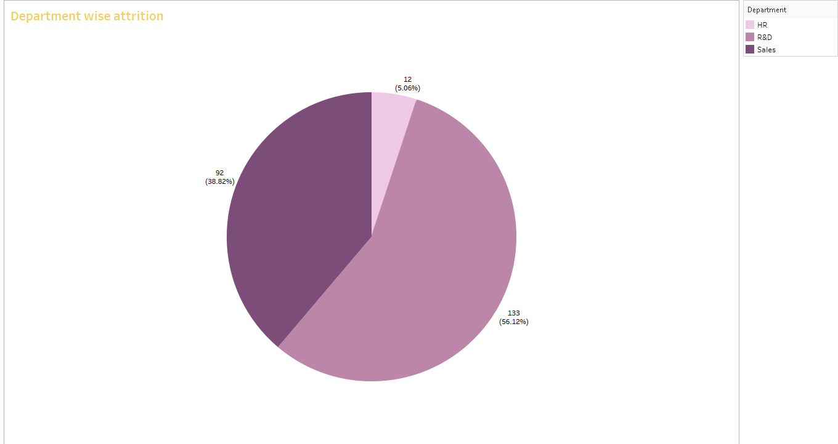
DEPARTMENT WISE ATTRITION

Slide 4
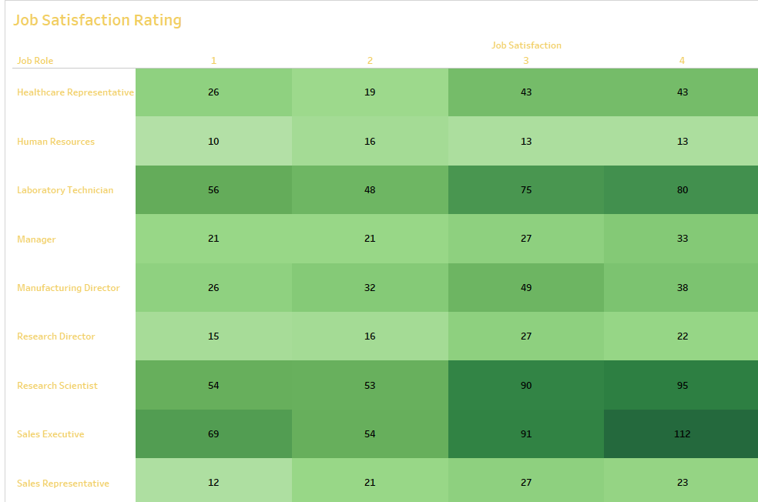
JOB SATISFACTION RATING

Slide 5
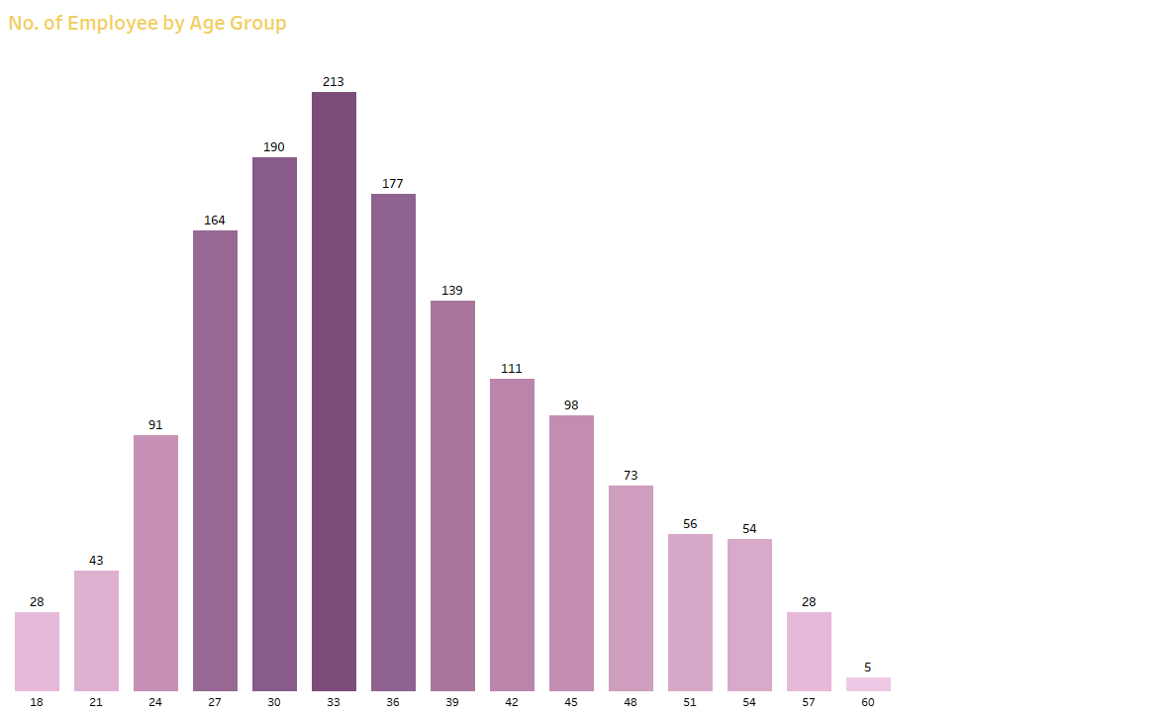
NUMBER OF EMPLOYEE BY AGE

Slide 6
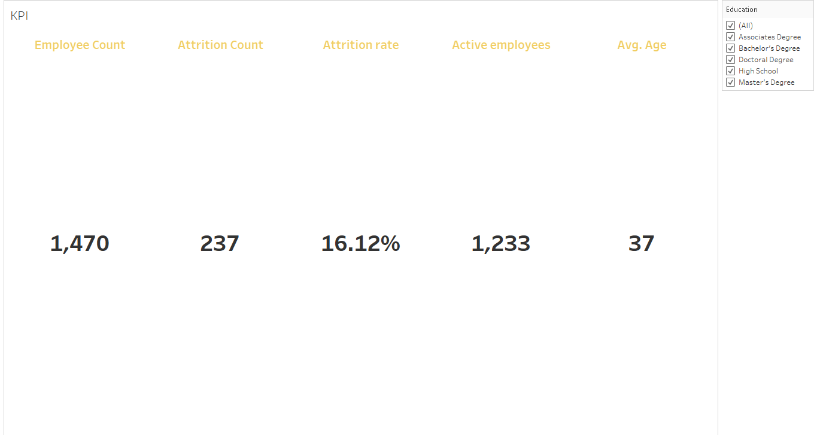

Slide 7
